Slide 1
Python 101
functions, modules

Slide 2
last time
algorithms
standard input and output
variables and data types
bugs and debugging
python functions

Slide 3
computer science
… or IT (Information Technology)?
Notes:
all about information → converting it to binary, modelling it

Slide 4
numeral systems
Notes:
theory time

Slide 5
decimal
(also called base-10)
Notes:
how does it work

Slide 6
digits: 0–9 base number: 10

Slide 7
1873.64
+
-
10³
10²
10¹
10⁰
10⁻¹
10⁻²
$$1×{10}^{3}+8×{10}^{2}+7×{10}^{1}+3×{10}^{0}$$
$$= 1000+800+70+3=1873$$

Slide 8
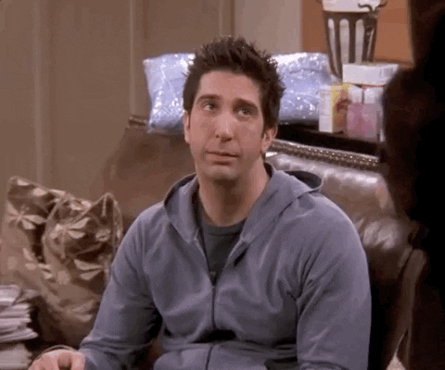
Notes:
1873 = 1873 wow

Slide 9
binary
also called base-2

Slide 10
digits: 0–1 base number: 2

Slide 11

0
1

Slide 12
1101.00
+
-
2³
2²
2¹
2⁰
2⁻¹
2⁻²
$$1×2^{3}+1×2^{2}+0×2^{1}+1×2^{0}$$
$$=8+4+0+1={13}_{(10)}$$
Notes:
now you know how to convert from decimal to binary, yaay

Slide 13

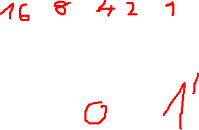
10110
Notes:
22 in decimal (16 + 4 + 2)

Slide 14
computer science
… or IT (Information Technology)?
Notes:
all about information → converting it to binary, modelling it

Slide 15
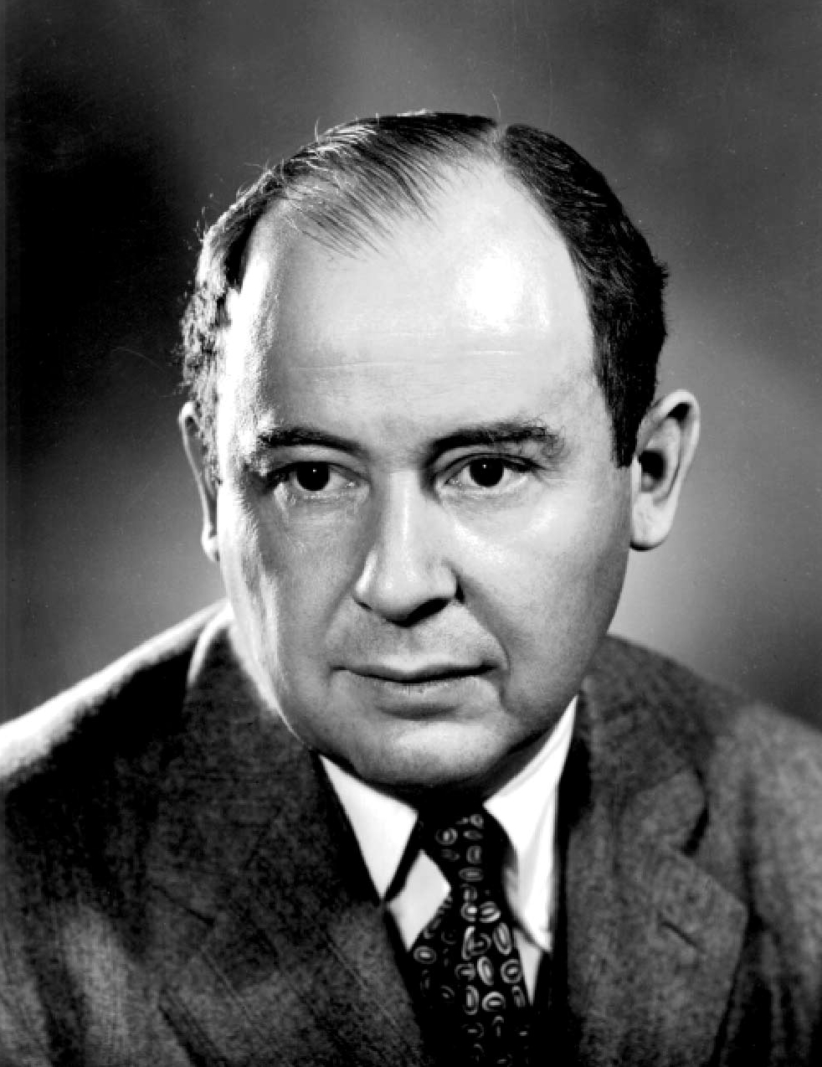
Notes:
it has to do with this man
father of modern computers

Slide 16
binary
…but why?
Notes:
physics, electricity

Slide 17




using binary
computers ❤ binary
numbers, text, music, videos, streams…
bit: binary digit
bit > byte > kilobyte > megabyte > gigabyte …
Notes:
computers: capacitor, transistor
HDDs: direction of magnetization
optical drives: pits and lands (light)

Slide 18
spicy fun fact #1🌶️
consumer electronics vendors legally lie to us 🫠
ever wondered why the 1 TB external HDD is only like ~953 GBs instead of 1024?
it all comes down to laziness
kibibyte vs kilobyte

Slide 19
images
Notes:
how do digital images work? any words?
remember: IT is about coding stuff to binary

Slide 20
terms
pixel: smallest unit
resolution: number of pixels as a product width×height
rgb: storing colors (w/ 3 primary colors)

Slide 21
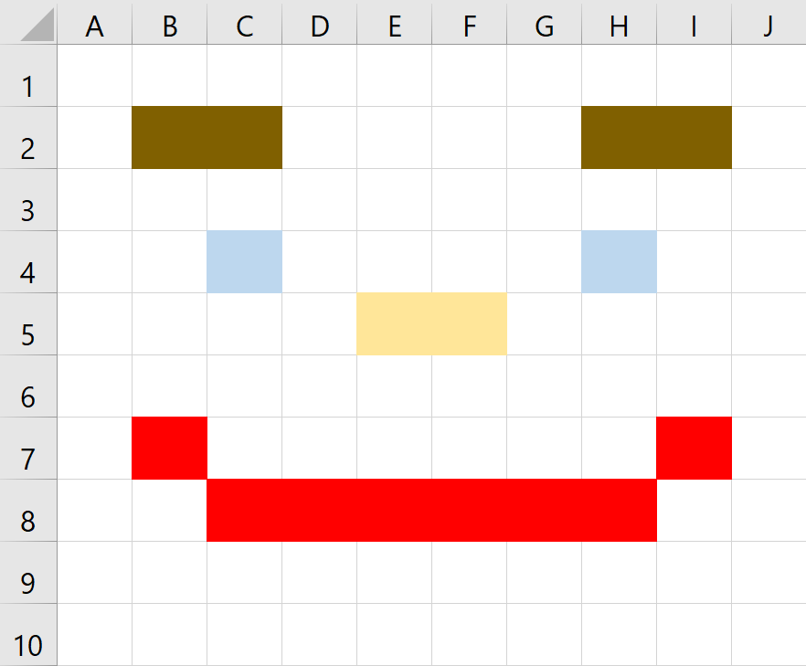
Notes:
what is the resolution of this image?
how many pixels we need to store information about?

Slide 22
bitmap
Notes:
one of the worst ways to store an image

Slide 23
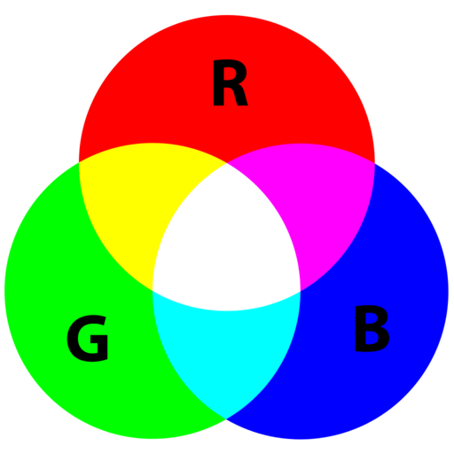
Notes:
from painting
mixing primary colors
1 byte

Slide 24
0000 0000 1111 1111
Notes:
0 and 255, respectively
how much data we need for 1 px? → 3 bytes, 1 for each primary color

Slide 25
4K resolution image
3840×2160
Notes:
what does resolution mean again?

Slide 26
8 294 400 pixels
8 294 400 × 3 × 8
Notes:
eight million, two hundred and ninety four thousand, 400 hundred pixels
how much data?

Slide 27
199 065 600
ones and zeroes
Notes:
onehundred ninetynine million,
sixtyfive thousand,
6 hundred 1s and 0s
now imagine videos, streams…

Slide 28
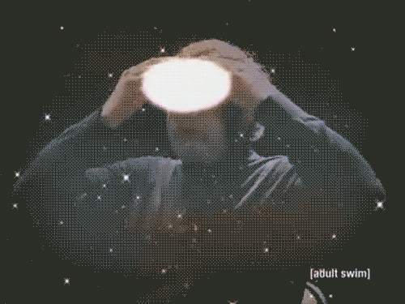

Slide 29
time to code

Slide 30
input
output
Notes:
remember this one from last time?

Slide 31
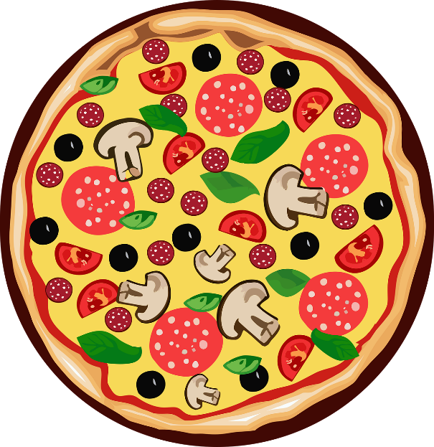

32 cm
>
24
cm
<
=
Notes:
how can we solve this?
diameter vs radius, we also need PI

Slide 32
1
our program
32
area1
2
area2
24
Notes:
how many inputs and outputs do we need?

Slide 33
print(10, "apples")
Notes:
we can use as many parameters / arguments as we want
they will be separated by a space on the std. output

Slide 34
modules
Notes:
extra functionality which is not included by default

Slide 35
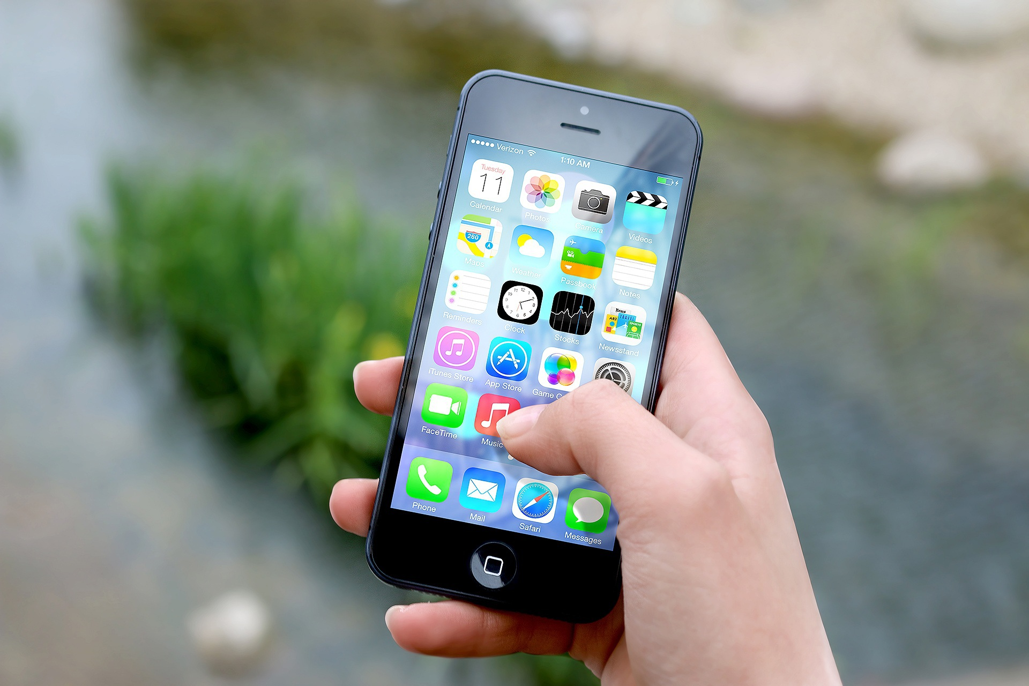

Slide 36
import math

Slide 37
math.pi
Notes:
fully qualified name
it is a variable, just like our variables → but this avoids ambiguity
(2 shoeboxes with same labels in different aisles –> which one to use? this makes it clear)

Slide 38
improving the code
are there any repeating patterns in our calculations?

Slide 39
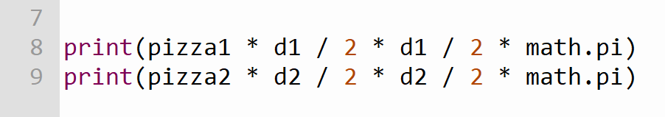

Slide 40
DRY principle
Don’t Repeat Yourself
Notes:
creating reusable codes
these languages do this with functions!

Slide 41
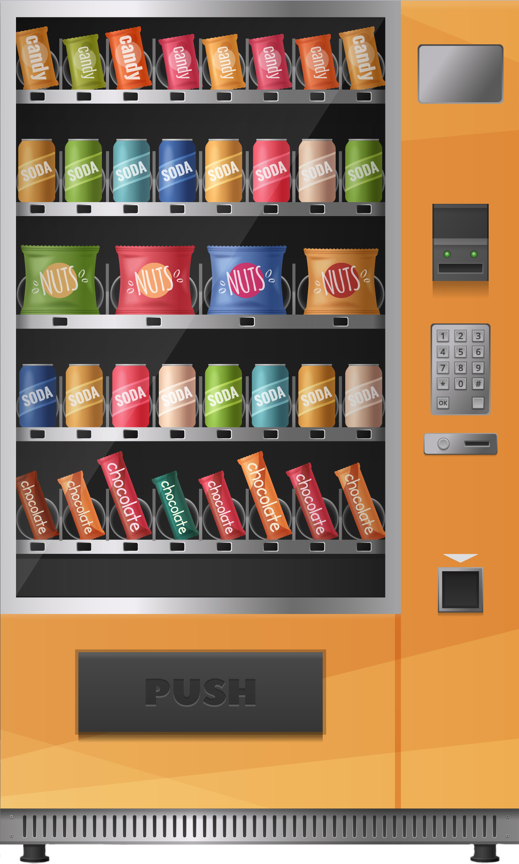

Input 1: food / drink id
Input 2: change
functions
Output: soda
Notes:
examples of functions: vending machine

Slide 42
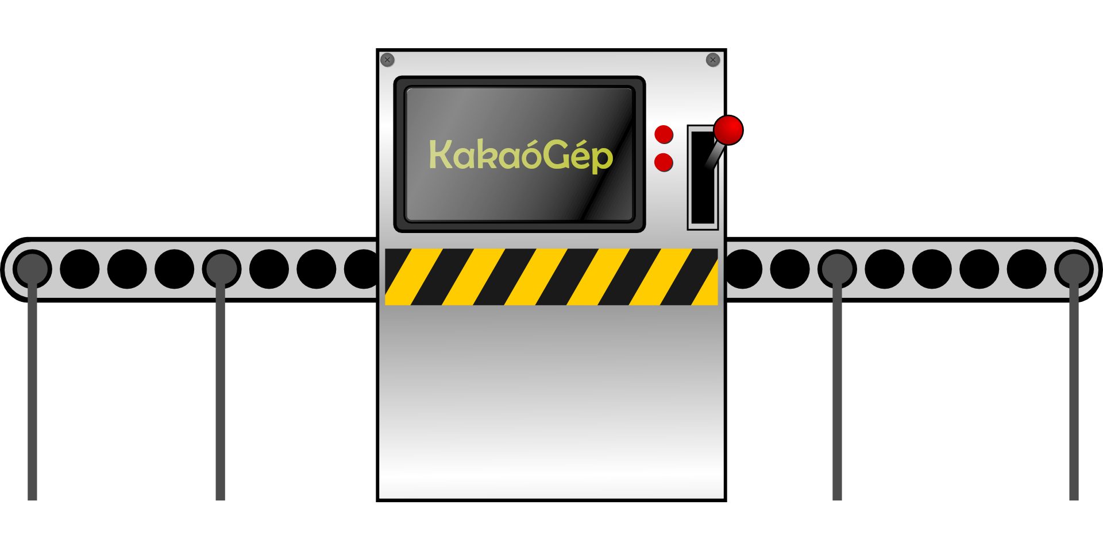


conveyor belt: preparation

Slide 43

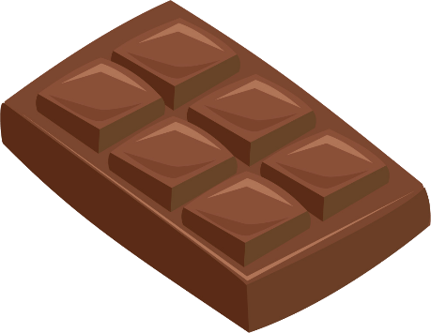
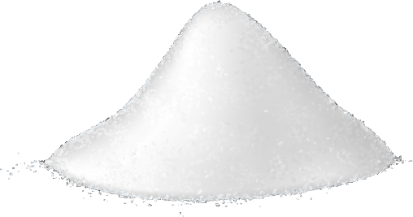

conveyor belt: execution

Slide 44
input
output
Notes:
in a way we are creating a new black box
like creating a new EXCEL function

Slide 45
number of pizzas
our area function
area
diameter

Slide 46
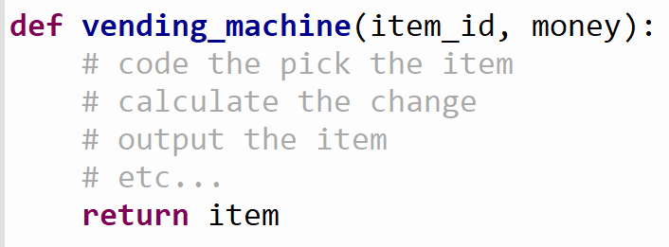
unique name
input
output

Slide 47
practice

Slide 48
what we learned today 1
introducing the pizza problem
improving UX in programming
using built-in libraries
functions

Slide 49
next time
logic
flowcharts
conditionals (decision-making)
RNG
… and much more!

Slide 50
Sources
Neumann János: https://hu.wikipedia.org/wiki/Neumann_J%C3%A1nos#/media/F%C3%A1jl:JohnvonNeumann-LosAlamos.jpg. Downloaded on 13 April.
Ross from friends GIF: https://i.giphy.com/media/S6qkS0ETvel6EZat45/giphy.gif. Downloaded on 13 April.
Light bulb: https://pixabay.com/vectors/light-bulb-electric-electric-bulb-146595/. Downloaded on 13 April.
Mind blown GIF: https://i.giphy.com/media/lXu72d4iKwqek/giphy.gif. Downloaded on 13 April.
Phone: https://pixabay.com/photos/iphone-hand-screen-smartphone-apps-410311/?download. Downloaded on 13 April.

Slide 51
Sources
Pizza: https://pixabay.com/vectors/pizza-food-clipart-icon-pepperoni-7503664/. Downloaded on 13 April.

